Slide 1
Shared Leadership for Superintendents,
Central Office, and District Leadership Teams
Brian A McNulty Ph.D.

Slide 2
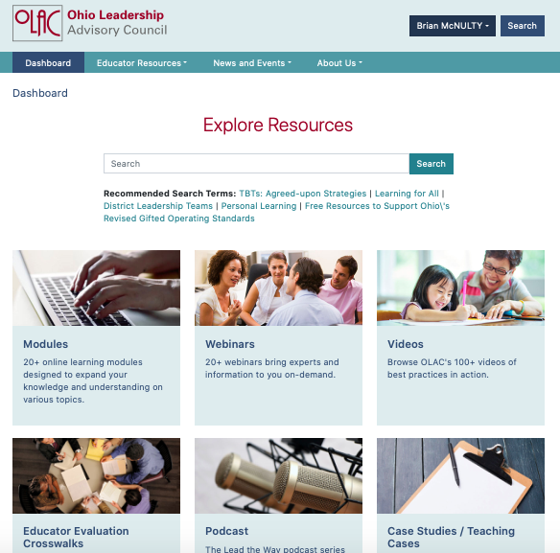
www.ohioleadership.org

Slide 3
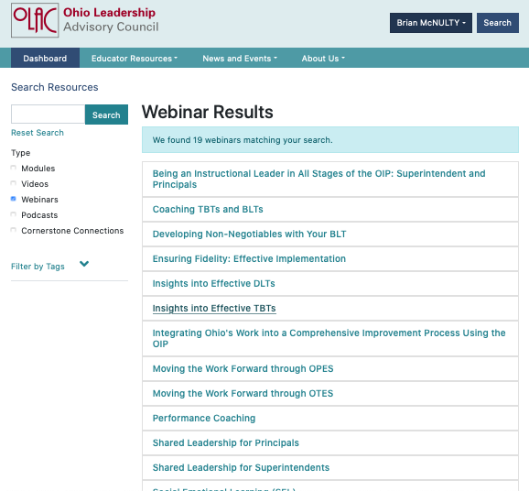

Slide 4
Theory of Action
Teacher
Learning
Classroom
Practice
Student
Learning
IMPACTING
IMPACTS
IMPACTS
VIF

Slide 5
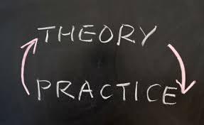
Theory of Change
A Theory of Action, or a Logic Model, is a blueprint of the change process that provides a visual diagram or outcome map that depicts the relationships between the strategies and intended outcomes and results.

Slide 6
Consistent reforms were enhanced when all members of the central office, and teams operated with a shared theory of action.
Chrispeels, et al., (2008)

Slide 7
Central office staff and teams benefit from more clearly articulating a theory of action regarding teams and their role in the improvement process.
Chrispeels, et al., (2008)

Slide 8
Learning and using new research-based practices in teacher teams
Data
Focused goals and strategies
TBTs/ BLTs/ DLT
Increase quality of teaching and leadership
Increased Student Learning
On-going PD, monitoring, feedback, reflection, and learning
Handout

Slide 9
Theory of Action
Teams
DLT
BLT
TBT
Shared Leadership
Focus
Improved Teaching and Learning
Improved Student Outcomes
5-Step Inquiry Process
Collaborative Inquiry
Instructional Leadership
Handout

Slide 10
Three Non-Negotiables
Common Focus
Shared Leadership and Collaborative Inquiry
Teams at Every Level That Use the 5-Step Process (Protocol)

Slide 11
Theory of Action
Teams
DLT
BLT
TBT
Shared Leadership
Focus
Improved Teaching and Learning
Improved Student Outcomes
5-Step Inquiry Process
Collaborative Inquiry
Instructional Leadership

Slide 12
Three Non-Negotiables
Common Focus
Shared Leadership and Collaborative Inquiry
Teams at every level that use the 5-step process (protocol)

Slide 13
Non-Negotiable # 1
Common Focus

Slide 14
Focus Is the First Obligation of Leaders.
Reeves, 2011
Reeves (2011, 2019)

Slide 15
1. Focus
Marzano, Waters, McNulty (2005)
Sanborn (2006)
Robinson (2011)
Reeves (2011, 2019)
Schmoker (2011, 2019)
McNulty & Besser (2011)
McChesney, et al. (2012)
Keller & Papason (2013)
Goleman (2013)
Smith & White (2014)
Hansen (2018)

Slide 16
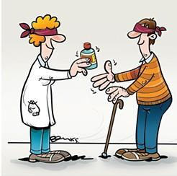
Based on a double-blind review of more than 2000 schools…
Reeves, 2011, 2019

Slide 17
The single variable that had the highest relationship with increased student performance was...
Reeves, 2011

Slide 18
In a 5-year study of 5,000 leaders, the number one reason for success was…
FOCUS
“Do Less, Then Obsess”
Hansen (2018)

Slide 19
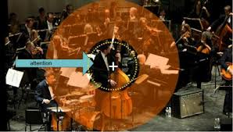
Directing attention toward where it needs to go is a primal task of leadership.
Goleman, 2013

Slide 20
The Work of the DLT
DLT
FOCUS

Slide 21
DLT Work
DLT
Focus – Schools have too many priorities. The DLT needs to give schools a clear Focus that their number one priority is Collaborative Inquiry in their TBT and BLTs.
The DLT needs to ensure that all of the teams use the new OIP 5-step process.
This process is an Inquiry Process.

Slide 22
Focus Actions
The Superintendent and the DLT must direct the BLTs to FOCUS on their TBTs.
Specifically, they need to focus on the effectiveness of their Inquiry Teams.
TBTs must be clear about how they will learn and use “What works for our kids here?”
BLTs must focus on supporting their TBTs and learning from them.

Slide 23
DLT Work
DLT
School Updates - There should be an annual schedule of schools who will present to the DLT.
For smaller districts, this should include all schools on an annual basis.
For larger districts, there should be a strategic sampling of schools that guides the DLT decision making.

Slide 24
DLT Work
DLT
School Updates
Each school should:
Self-assess where their TBTs are in terms of progress (using the rubric)
Identify their strongest teams (how many - percentage)

Slide 25
DLT
DLT Work
School Updates
BLTs should report on their Strongest Teams:
How many of these teams are there? (percentage)
Why are these teams stronger?
What progress have they made? How?
What are they doing?
How do you know? Evidence?
Bring a 5-minute video that demonstrates a successful TBT

Slide 26
DLT
DLT Work
School Updates
BLTs should report on their Struggling Teams:
How many of these teams are there (percentage)
Why are these teams struggling?
What has the BLT done to help them?
What supports from the DLT would help you?

Slide 27
DLT
DLT Work
DLT Observations
DLT members should periodically visit school BLT and TBT meetings and aggregate observation data to align with data received from schools.
The DLT should monitor the effectiveness of their supports to BLTs and TBTs.

Slide 28
5-Step Process for DLTs
DLT
Examples of data for DLT (e.g., TBTs/BLTs)
Outcome – student performance indicators
Cause data – adult performance indicators, i.e., effectiveness of their TBTs
Analyze data
Strengths/weaknesses
Act on data - review action steps, select strategies, differentiated PD, coaching, etc.
Evaluate the effectiveness of the PD provided

Slide 29
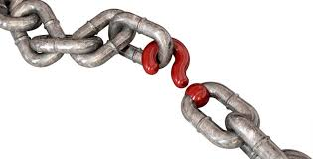
Missing Links
BLTs and DLTs are not holding themselves responsible for moving the collaborative work of BLT and TBTs forward.
They are not monitoring themselves.
They are not acting on their own data.
They are providing limited differentiated PD to their schools.

Slide 30
DLT
DLT Work
Meet monthly
Analyze outcome and cause (monitoring) data
Review/decide action steps. Select specific powerful actions to move the work forward with their BLTs and TBTs
Provide feedback to schools and staff (Frequency?)
Assure the provision of powerful learning
Between meeting - monitor, provide support/PD
Communicate to staff and report to BLTs

Slide 31
Getting colleagues focused on evaluating their impact.
ES = .91
Hattie 2015
Notes:
Everyone needs to own the progress
Think DLT, BLT and TBTs

Slide 32
How effective are…
DLT
TBTs/BLTs/DLT?
What evidence are you using to make decisions?
What other data should you be considering?

Slide 33
Theory of Action
Teams
DLT
BLT
TBT
Shared Leadership
Focus
Improved Teaching and Learning
Improved Student Outcomes
5-Step Inquiry Process
Collaborative Inquiry
Instructional Leadership

Slide 34
Three Non-Negotiables
Common Focus
Shared Leadership and Collaborative Inquiry
Teams at every level that use the 5-step process (protocol)

Slide 35
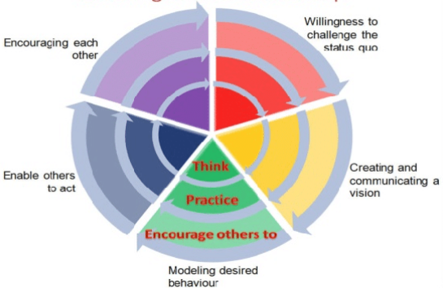
Non-Negotiable # 2
Shared Leadership and Collaborative Inquiry
Enabling Shared Leadership

Slide 36
Why share leadership—and for what purpose?
WHY
ARE
WE
DOING
THIS

Slide 37
Why – Shared Leadership
Life and organizations are too fast and complex for any single individual to change, adapt, and know enough to address complex and novel situations that face us.
We are not smart enough…
We are not quick enough…
We are not strong enough…
We are not open enough…
We don’t have enough different experiences…
Adult and student learning is very complex.

Slide 38
Largest Leadership Study to Date
Nine states
43 school districts
180 schools
Data from a total of 8,391 teachers and 471 school administrators
Seashore Louis et. al, 2010

Slide 39
Research has found that…
1. Collective leadership has a stronger influence on student learning than any individual source of leadership
2. Higher-performing schools award greater influence to teacher teams
Seashore Louis et. al, 2010

Slide 40
What is the purpose?
Put simply, to improve complex organizations like schools and districts, we need to maximize and utilize all of our talents. (Goldsmith 2010 HBR)

Slide 41
Collective Action…
Equals
Effective
Outcomes!

Slide 42
Designed everyone’s work primarily in terms of improving the capacity and performance of someone else
RECIPROCAL
ACCOUNTABILITY
ACCOUNTABILITY
Elmore (2006)

Slide 43
The principle of reciprocity applies to all accountability relationships; there can be no demands without attention to the capacity that exists to deliver them.
RECIPROCAL
ACCOUNTABILITY
ACCOUNTABILITY
Elmore (2006)

Slide 44
If anyone’s practice is subject to observation, analysis, and critique, then everyone’s practice should be.
Elmore (2006)

Slide 45
Leaders who are successful at sharing leadership…
…have a higher level of Emotional Intelligence (EQ).

Slide 46
Sharing leadership demands emotional intelligence.

Slide 47
Emotional Intelligence and Shared Leadership
Emotional Self-Awareness
Emotional Self-Control
Adaptability
Empathy
Organizational Awareness
Conflict Management
Handout
Goleman 2017

Slide 48
How do you effectively share leadership?
Clear goals, outcomes, expectations to all teams and members
Clear responsibilities
Provision of resources, support, and PD
Shared or reciprocal accountability
EQ

Slide 49
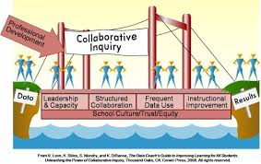
Non-Negotiable # 2
Shared Leadership and Collaborative Inquiry

Slide 50
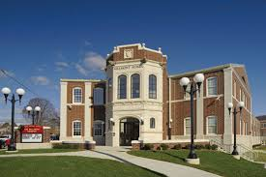
Leaders in high-performing districts…
…engaged school staff members in collaborative inquiry about student learning and teacher performance in their schools.
Leithwood and Seashore-Louis, 2012

Slide 51
Supported By Study After Study
Collaborative schools do better than individualistic ones.
Teachers who work in professional cultures of collaboration tend to perform better than teachers who work alone.
Hargreaves & Fullan, 2012

Slide 52
Collaborative inquiry is among the most promising strategies for strengthening teaching and learning.
The biggest risk, however, is not providing the necessary leadership and support.
David, J.L., (2008 and 2009)

Slide 53
Collaboration does more to advance teachers’ instructional practices than other learning opportunities for individual teachers.
Schleifer, et al 2017

Slide 54
The frequency of collaborative discussion with peers had one of the largest significant effects on teachers’ self-reported changes in instruction.
Schleifer, et al 2017

Slide 55
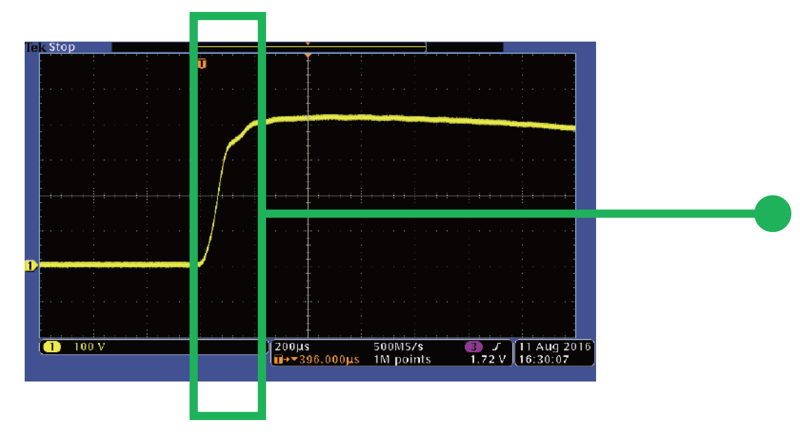
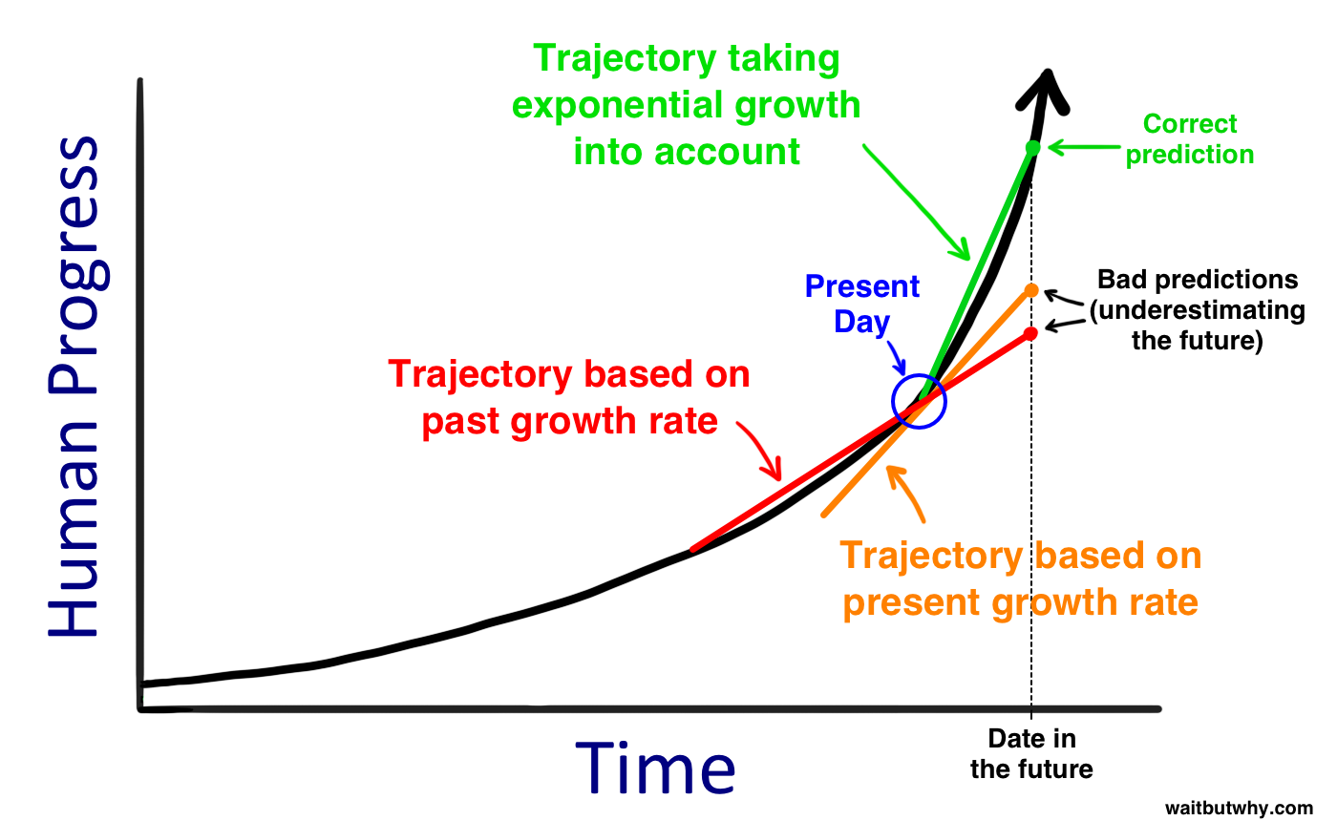
Teachers improve at faster rates when working in schools with strong quality collaboration.
Ronfeldt 2017

Slide 56
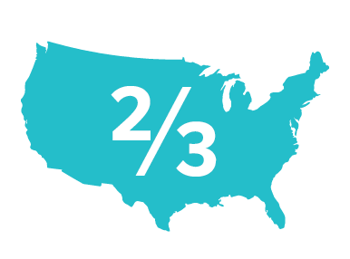
More than two-thirds of older and younger teachers in a national survey said they prefer a school characterized by collaboration among teachers.
Schleifer, et al 2017

Slide 57
Teachers explained that knowing that their colleagues were also trying new activities and were willing to discuss successes and failures inspired them to take risks that they would not have taken otherwise.
Schleifer, et al 2017

Slide 58
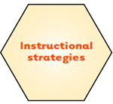
In a survey of over 9000 teachers, they perceived that the most helpful and effective focus of collaboration…
…was in developing instructional strategies.
Ronfeldt 2017

Slide 59
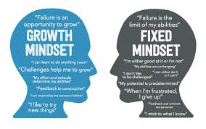
Mindset (Dweck -2019)
Growth Mindsets are not just for students.
A growth mindset for educators is…
“How do I improve?”
Individually?
Collectively?
All educators can get better!

Slide 60
As a rule, teachers learn better together…
…than they do alone.
Hattie & Zierer 2019

Slide 61
Professional development has little or no impact when it relies on individual learning and does not focus on follow-through support for teams of teachers to learn together.
Hargreaves & Fullan 2012

Slide 62
Humans are genetically wired for teams.
Cooperation actually engages the reward regions of our brains.
Karlgaard, & Malone (2015)

Slide 63
The absence of collaboration kills…
Culture
Productivity
Results
Mautz 2019

Slide 64
Theory of Action
Teams
DLT
BLT
TBT
Shared Leadership
Focus
Improved Teaching and Learning
Improved Student Outcomes
5-Step Inquiry Process
Collaborative Inquiry
Instructional Leadership

Slide 65
Three Non-Negotiables
Common Focus
Shared Leadership and Collaborative Inquiry
Teams at every level that use the 5-step process (protocol)

Slide 66
Three Non-Negotiables
Common Focus
Shared Leadership and Collaborative Inquiry
Teams at every level that use the 5-step process (protocol)

Slide 67
Collaborative Inquiry Teams at Each Level of the System (TBTs, BLTs DLTs) That Are Learning Themselves, and from Each Other

Slide 68
District Leadership Team
Building Leadership Team
Teacher Based Team
Teacher Based Team
Building Leadership Team
Teacher Based Team
Teacher Based Team
Teacher Based Team
Teacher Based Team
Notes:
Slide 5
This visual shows how the DLT – BLT – TBT structures work in a district. The district has to lead the work and provide the framework and parameters so there is consistency of understanding across the district. This visual shows how this process allows all staff to be a part of a learning organization because everyone is involved in a collaborative structure. The visual will look somewhat different in a community school. See the next slide.

Slide 69
All of the teams do similar work.

Slide 70
Why does the OIP use teams as the primary method for improvement?
Take a few minutes and identify why you think that the OIP uses teams.

Slide 71
WHY does the Ohio Improvement Process use teams as the primary method for improvement?
Reflection/Discussion

Slide 72
We don’t have TBTs/BLTs/DLTs to have teams.
The purpose of the teams is to achieve better outcomes.

Slide 73
A New Way to Think about Change
Using Teams to Lead Change
Christakis, &Fowler (2009, 2011)
Kegan & Lahey (2009)
Prochaska, Norcross,& DiClemente, (2007)
Rosenberg, T. (2012)
Oz, M., (2012)
Karlgaard & Malone (2015)

Slide 74
Teams are more likely to come up with really great new ideas.
Karlgaard, & Malone (2015)

Slide 75
Experimental studies have found that, in comparison with working alone, team members show as much as a 50 percent increase in performance during teamwork…
…because they do not want to let their teammates down.
Karlgaard, & Malone (2015)

Slide 76
Change Occurs More Readily In Teams
“”
Risk Sharing
And Shared Accountability
Notes:
Risk sharing or risk distribution across a groups allows individuals to take greater risks than they would as individuals

Slide 77
Research establishes that groups of teachers, working together in purposeful ways over periods of time, will produce greater learning in more students….
Fullan (2014)

Slide 78
If schools (teachers, principals/BLTs/DLTs) can directly influence how teachers learn together, they will maximize their impact on student learning.
Fullan (2014)

Slide 79
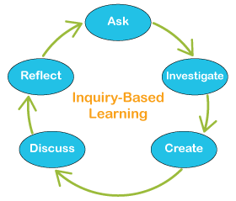
All of our improvement work should be about Inquiry and Learning.
Ask
Reflect
Investigate
Inquiry-Based
Learning
Discuss
Create

Slide 80
Three Non-Negotiables
Common Focus
Shared Leadership and Collaborative Inquiry
Teams at every level that use the 5-step process (protocol)

Slide 81
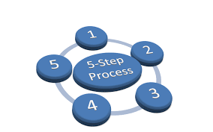
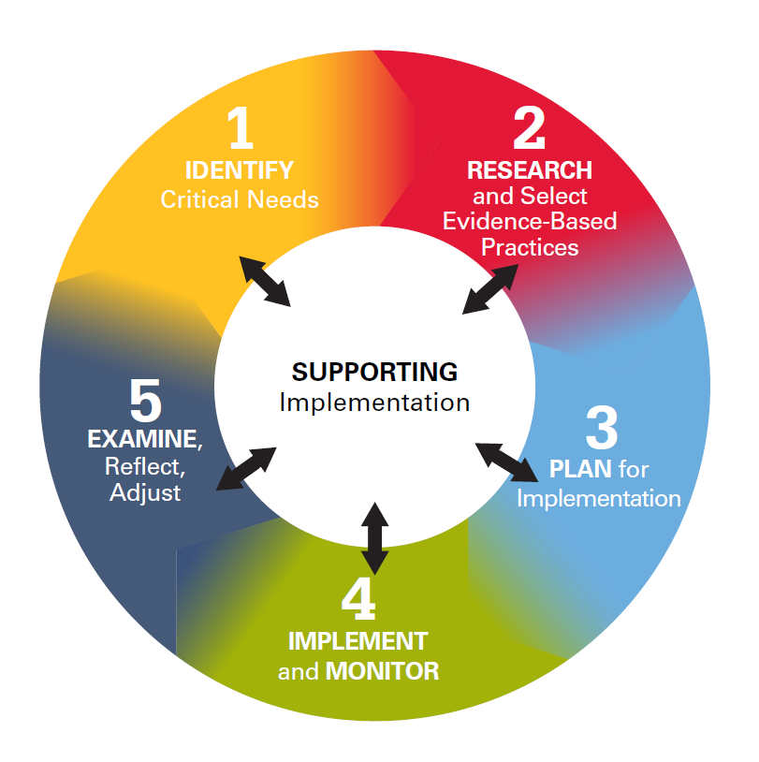
5-Step Process (Protocol)

Slide 82
The Ohio Improvement Process
Notes:
p. 5 handouts. This represents the transition to the new OIP process
Each step follows and should be discussed. Leaders need to know this process in order to use it to build the instructional capacity of teachers

Slide 83
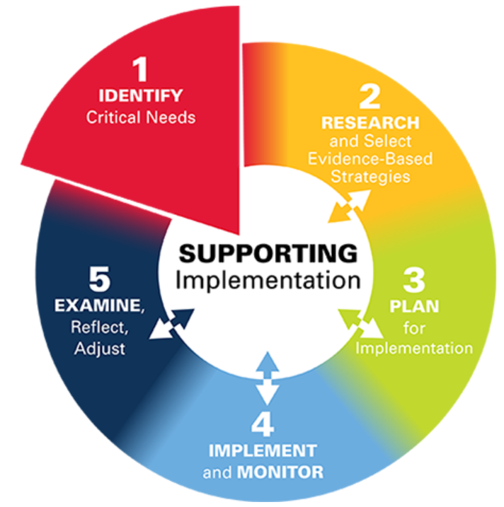
Step 1: Identify Critical Needs
Engaging in identifying critical needs is the first step. The process begins by collecting and analyzing data.
Notes:
p. 5 handouts

Slide 84
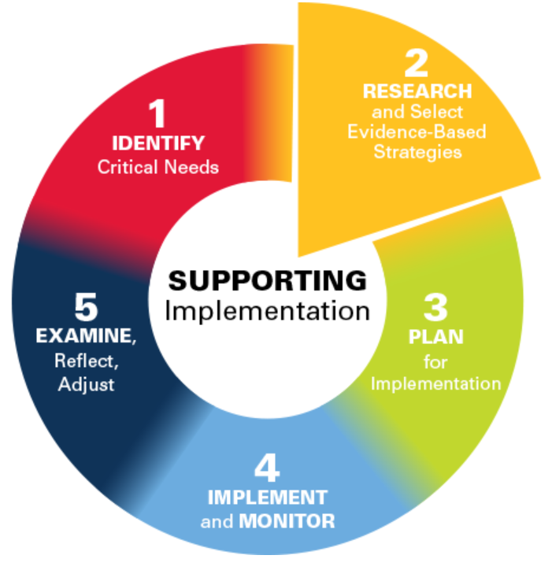
Step 2: Research and Select Evidence-Based Strategies
Research and select evidence-based practices that address those identified critical needs.
Some of the benefits of selecting an EBP are:
An increased likelihood of positive student and adult impact
Less wasted time and resources
Notes:
p. 5 handouts

Slide 85
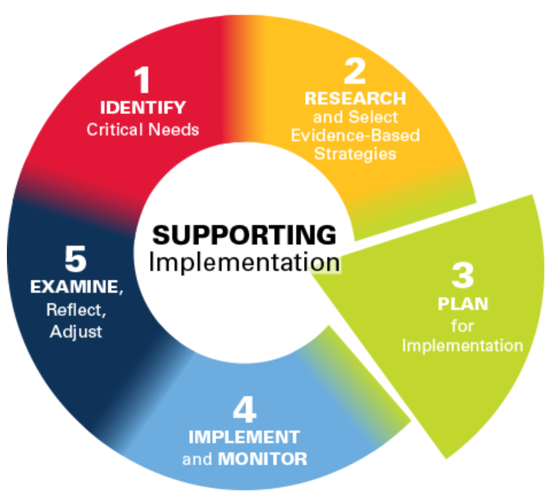
Step 3 Effective Strategy - Plan for Implementation
Co-creates a plan for intentional implementation of the selected Evidence-Based Practice including look-fors to ensure the strategy is supporting student learning as intended.
Notes:
p. 5 handouts

Slide 86
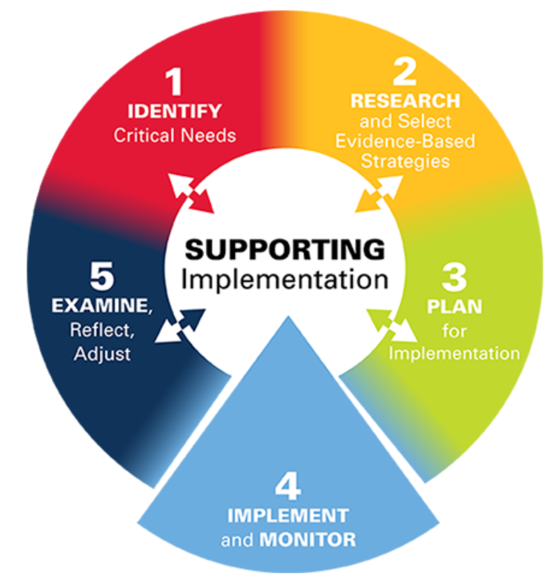
Step 4: Effective Strategy - Implement and Monitor
Implementation is the most complex part of the OIP primarily because it requires changes in adult behaviors and practices that are part of the unique culture of every district and every building. The implementation of well-aligned district or community school and building plans resides with the DLT, BLTs, and TBTs.
Monitoring is collaborative learning through observing implementation of the practice and its impact on students and their work.

Slide 87
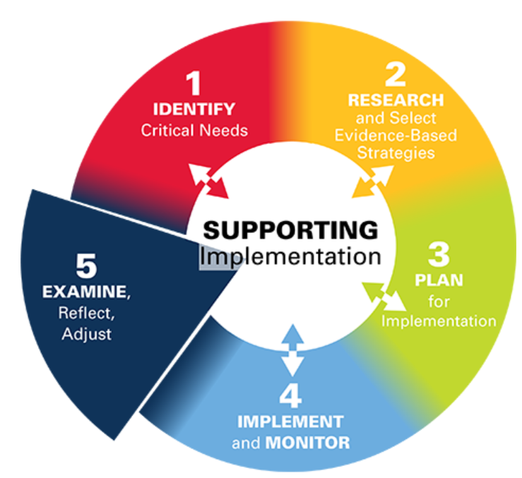
Step 5: Examine, Reflect, Adjust
Determine if the delivery of the evidence-based practices had the expected team outcomes.
Examine the implementation of adult practices and the impact on student performance
Reflect on successes to replicate and practices to improve
Adjust as needed
Notes:
p. 5 handouts

Slide 88
This is what the OIP is really about!
Sharing Leadership
Inquiry (What works?)
Collaborative Learning
Teams
Monitoring, Feedback, and Support
COMPLIANCE

Slide 89
This is what the OIP is really about!
Sharing Leadership
Inquiry (What works?)
Collaborative Learning
Teams
Monitoring, Feedback, and Support
What questions do we have about how out students learn best?
What have we learned together as teams?
COMPLIANCE
How can we provide more effective feedback and support to each other at all levels?

Slide 90
Better outcomes for students…
…come from better collective inquiry and learning on the part of all staff.

Slide 91
Theory of Action
Teams
DLT
BLT
TBT
Shared Leadership
Focus
Improved Teaching and Learning
Improved Student Outcomes
5-Step Inquiry Process
Collaborative Inquiry
Instructional Leadership
Handout

Slide 92
Three Non-Negotiables
Common Focus
Shared Leadership and Collaborative Inquiry
Teams at every level that use the 5-step process (protocol)

Slide 93
All successful school systems have come to trust and respect teachers.
Fullan (2010)

Slide 94
Brian A. McNulty Ph.D.
Creative Leadership Solutions
Brian.McNulty@creativeleadership.net
303-819-1625

