Slide 1

Developing School
Non-negotiables
Webinar
Brian A McNulty Ph. D.

Slide 2


Before we begin…
Download the handouts

Slide 3
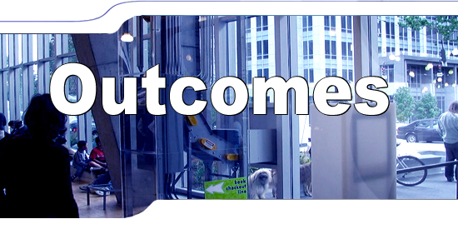
Explore the concept of Non-negotiables, including reviewing different examples
Begin the process of developing your own school’s non-negotiables
Make decisions and commitments for follow-up action

Slide 4

The first question…

Slide 5


Where are you headed as a school?
The answer to this question
is your vision

Slide 6


IF you already have a vision for your school
Stop here and
Revisit your vision with your BLT

Slide 7

If you don’t have a vision for your school
Review and follow the directions on the next four slide

Slide 8

Visioning
Mental process in which images of the desired future (goals, objectives, outcomes) are made intensely real and compelling to act as motivators for the present action.
http://www.businessdictionary.com/definition/visioning.html

Slide 9
Visioning
The process starts with the BLT establishing and agreeing on a vision of why is our school here?
Visions are based on deep beliefs about how the world should be
And how we want our school to be.

Slide 10

Your vision for your future school
What does your future school look like?
  For Kids?
  For staff?
  For you personally?
What outcomes do we want?

Slide 11
Stop the webinar
Review Handout #1 – establishing a vision
Work with your BLT to establish a DRAFT vision statement
If you already have a vision statement review and discuss this with your BLT

Slide 12



Slide 13
What are non-negotiables?
“Non- negotiables” are agreements, principles, core beliefs, or values that are absolutes, we agree we will not vary from them
Once established and adopted, they are not open to negotiation, we will never compromise these values
These are the “hills we will die on!”

Slide 14

Why are non negotiables important?
At it’s core, education is value and belief driven
It is WHY we do this work
Unless we have clearly articulated values that we hold ourselves to, unconscious biases and past practices keep us from achieving our aspirational values
If this happens we end up with conflicts and confusion in our school
Consistently holding ourselves to our beliefs is a way of unifying ourselves as a staff

Slide 15


3 Examples of non-negotiables

Slide 16
Example #1 Project Non-negotiables

Slide 17
Project
CORE VALUES
OLi⁴ promotes equity and social justice.
OLi⁴ presumes the competence of all learners.
OLi⁴ regards access to a high-quality general education curriculum as every student’s educational right.

Slide 18
Project
WARRANTED BELIEFS ABOUT CHANGE
Improved learning – both for students and staff – must be the central focus of districts’ and schools’ efforts to foster systems change
Systems change requires focused action
Systems change requires capacity-building.
Systems change requires shared leadership.
Shared leadership builds collective responsibility and shared accountability

Slide 19


Read through and highlight the Project Non-negotiables and beliefs (handout # 2)
Have a discussion of what these mean
Are there any that might apply to your school?
Keep a list of non-negotiables for later

Slide 20


Example #2
Social Justice Non-negotiables

Slide 21

Examples of
Social Justice
Non-negotiables
The system is responsible for the prevention of student failure.
All students will attend the school and classrooms they would attend if not identified by a specific label (special education, advanced learner, RtI, linguistically diverse, at-risk, etc.) using principles of natural proportions –or proportional representation.
Frattura, & Capper, (2007)

Slide 22
Examples of
Social Justice
Non-negotiables
All instruction for all learners; including students with disabilities, linguistically diverse, students who are advanced and challenged learners, is premised on a rigorous core curriculum for all students.
Teacher-based teams of teachers co-plan and co-serve through proactive instructional practices for each and every learner within their grade-based on the principles of universal instruction, curriculum, and assessment.
Frattura, & Capper, (2007)

Slide 23
Read through and highlight all the Social Justice Non-negotiables handout (# 3)
Have a discussion of what these mean
Are there any that might apply to your school?
Keep this list of non-negotiables for later

Slide 24

Example #3 “Just Ask”
We ACT on our belief that ALL students can learn!
We accept learning as the fundamental principle of the school and examine all practices in light of their impact on learning.
We engage in and assume leadership for promoting collaborative practice.
We believe that all students belong to all of us.

Slide 25
Example #3 “Just Ask”
5. We collectively develop and adhere to clearly articulated norms.
6. We establish and maintain an atmosphere of mutual respect and trust
7. Isolation is not an option! Collaboration is a right and a responsibility.
8. All adults are committed to the success of all other adults.
9. We focus on results.

Slide 26
Read through “Just Ask” Non-negotiables handout (#4)
Have a discussion of what these mean
Highlight important ideas that might apply to your school?
Keep this list of non-negotiables for later

Slide 27

Developing your own non-negotiables

Slide 28
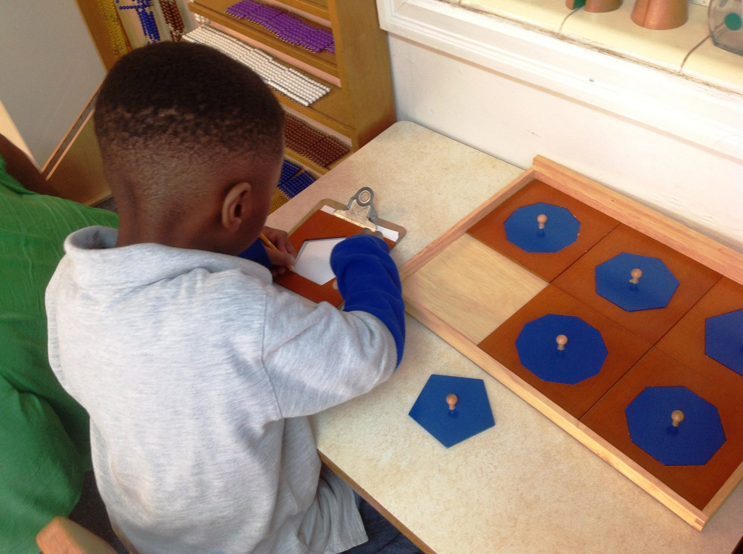
Developing your own non-negotiables
Step #1 Work individually
  Review each of the 3 examples (see your handouts)
  Capture some examples that are important for you
  Create your own list of values and beliefs
  Put your list of “DRAFT” non-negotiables on sticky notes or index cards

Slide 29
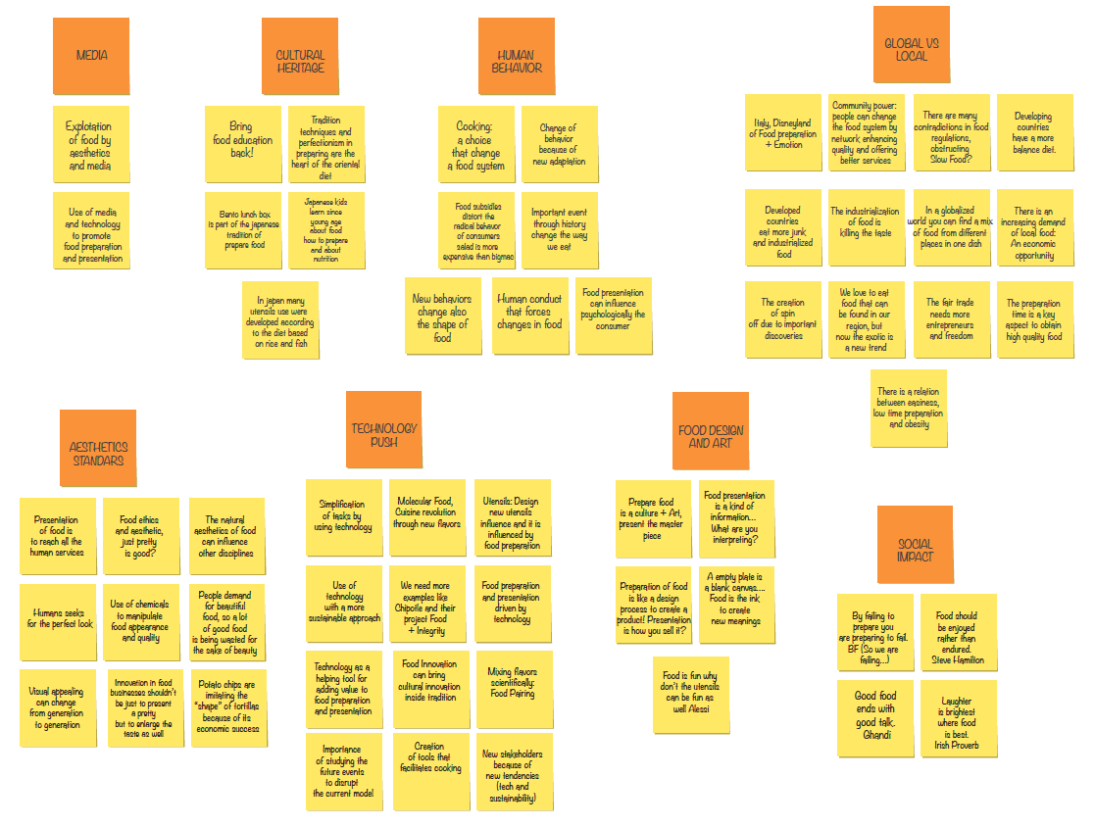
Step #2 Affinity grouping
Review and follow the directions on Handout #5 for Affinity Groups
Come up with your DRAFT Non-negotiables
Check your Non-negotiables against the 3 other examples of Non-negotiables

Slide 30


BLT Work
Step 1 Add detail
The next step is to add more descriptions to you Headline statements
Let’s look at some examples

Slide 31
Example # 1
Headine:
OLi⁴ presumes the competence of all learners.
Description:
The collective responsibility of educators to provide high quality instruction aligned with teacher level content to all students is realized through presuming competence and setting high expectations for all students. Curriculum and instruction should be rigorous, culturally relevant, and universally designed and accessible to all students, who are best served by being held to high expectations

Slide 32
Example # 2
Headline:
We act on our belief that all students can learn!
Description:
This, the most important non-negotiable, appears first on our list. Readers will note that there is extra punctuation for emphasis. The word all is underlined because we cannot disregard the learning needs of any individual. Every child we face in our classroom deserves our attention as well as our relentless effort to find the key to his success. The exclamation point at the end of the sentence denotes the passion with which we embrace the belief that all children will show clear evidence of learning. We know that it is not acceptable to simply believe in the ability of all youngsters to learn; it must be identifiable in our words and actions and the responses of the students. Without exception, we must see each child as a capable individual who can grow in knowledge and skills.

Slide 33
BLT Work
Add your own detail
Break up the BLT into small working groups
Assign a “Headline” to each small group
Each small group should add a descriptions of what the Headline means by adding more clarity and detail

Slide 34
BLT Work
Step #2- Critique the statements
As a BLT review and critique each Headline and statement using the “Last word” Protocol (handout #6)

Slide 35
BLT Work
Step #3 Distribute to staff and BLT use
Distribute this Final Draft list to the staff ask ask for input
“Massage” the Draft list until you have a Working Draft.
Use the Working Draft in your BLT meetings when you have to make a decision
After using the working Draft for 6 months in your decision making, finalize your non-negotiables and distribute them to all staff
Inform staff that the BLT is using these non-negotiables in their decision making for the school

Slide 36

Non-negotiables are only effective if used for decision making
The BLT should keep a list of decisions that were influenced by their Non-negotiables

Slide 38

Brian A McNulty Ph. D.
Brian.mcnulty@creativeleadership.net
303.819-1625

